Slide 1


Common Core Planning for
Content & Practice
Preparing Los Angeles Students for College and Career
Notes:
Instructor Notes: 30 seconds
SAY Welcome.
SAY In this session we will create discussion-based opportunities for student learning.
SAY To do this, please reconfigure yourselves in grade level alike teams.
SAY Together we will select and plan a cognitively challenging, Common Core aligned instructional task.

Slide 2
Outcomes
Plan a Common Core aligned problem-based lesson using John Van de Walle’s Three-Phase Structure
  Teachers will be expected to facilitate (at least) one problem-based lesson a week during the 2013-14 school year
Identify strategies that meet the needs of our diverse learners: English learners (EL), Standard English learners (SEL), Students with Disabilities (SWD), and students identified as Gifted and Talented (GATE)
Make connections between the Common Core Standards for Mathematical Practice and the enVisionMATH program
Notes:
Instructor Notes: 1 minute
SAY Let’s start with the stated outcomes for the session.
Review the session outcomes.

Slide 3
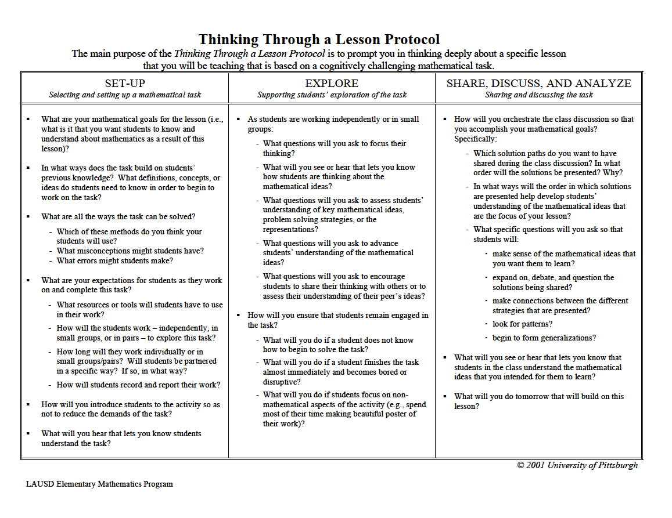
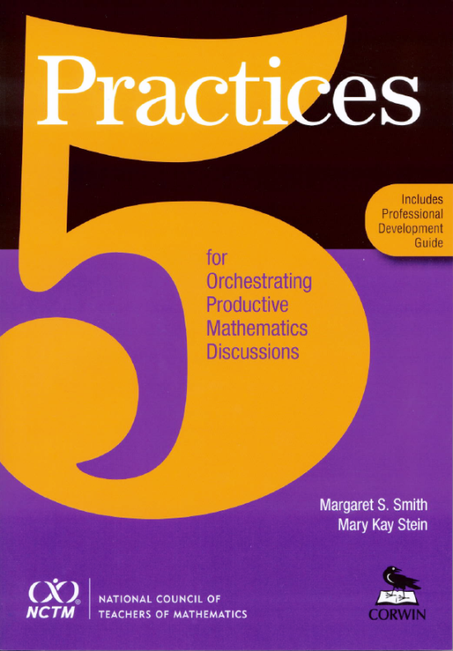
Three-Phase Structure
BEFORE
DURING
AFTER
Notes:
3
Instructor Notes: 2 minutes
SAY If you were teaching third, fourth, or fifth grade in LAUSD from 2006-2008 you will most likely remember the Thinking Through a Lesson Protocol.
SAY Today we will be using a similar, simplified planning tool, John Van de Walle’s Three-Phase Structure.
SAY In 3 stages, both the TTLP and the Before/During/After structure can be used to facilitate lessons that produce mathematically productive conversations.
(CLICK) SAY If you are interested in learning more about how to effectively coordinate classroom discussions, “5 Practices for Orchestrating Productive Mathematical Discussions” by Margaret Smith and Mary Kay Stein is an informative book that elaborates on the process.
SAY“5 Practices” is a more detailed look at the pedagogical ideas that ground both the TTLP and the Three-Phase Structure.
SAY Again, today we will be planning a lesson using the John Van de Walle Three-Phase Structure.
SAY When facilitated with fidelity, the Before/During/After structure generates lessons aligned with the Common Core practice standards.

Slide 4
Three-Phase Structure
BEFORE
5 Minutes
DURING
AFTER
Activate prior knowledge
Review vocabulary
Pose the problem
Ensure that students understand the task
Notes:
4
Instructor Notes: 30 seconds
SAY Let’s begin by reviewing the teacher actions associated with each of the three phases.
SAY Please find Handout #1.
Go over the components of the BEFORE phase with the group.

Slide 5
Three-Phase Structure
Let go!
Circulate as students independently work in pairs or groups
Ask questions to focus, assess, and advance student thinking
Decide which solutions will be selected for sharing
BEFORE
DURING
20 Minutes
AFTER
Notes:
5
Instructor Notes: 30 seconds
Review the components of the DURING phase.

Slide 6
Three-Phase Structure
Facilitate the sharing of two or more solution paths
Order selected solutions to help generate a mathematically productive discussion
Facilitate a student-centered discussion so that students:
  Develop an understanding of the concept
  Add on to and question solutions shared
  Make connections between the solutions presented
  Find generalized characteristics within the problem
Summarize the main idea and identify next steps, future problems
BEFORE
DURING
AFTER
15 Minutes
Notes:
6
Instructor Notes: 30 seconds
Review the components of the AFTER phase.

Slide 7
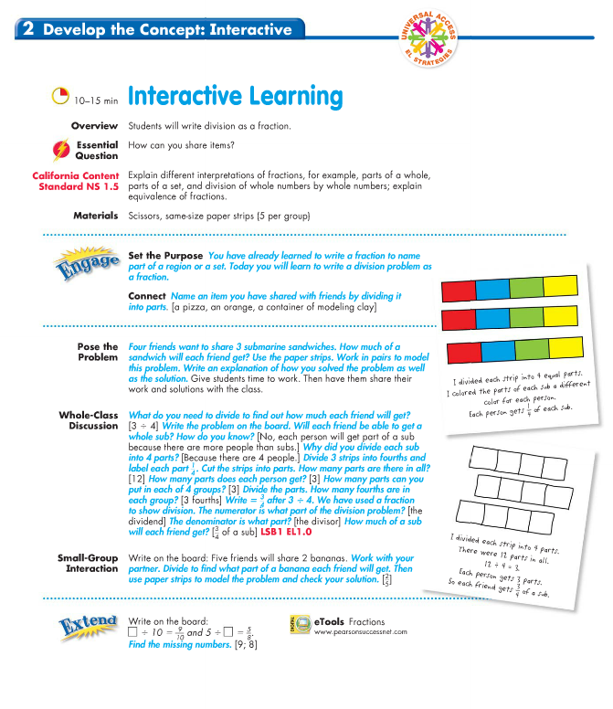
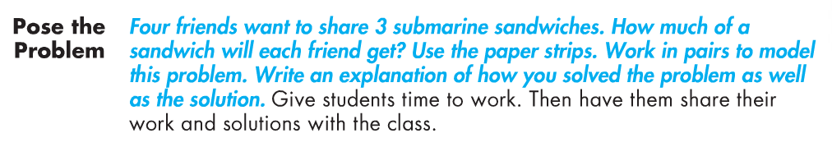
Anticipating
As a grade level team, select one task for planning purposes.
Task
Notes:
Instructor Notes: 5 minutes
SAY Please find the enVisionMATH Problem-Based Interactive Learning page for your grade level.
SAY This was taken directly from the enVisionMATH Topic Teacher’s Edition.
SAY John Van de Walle was one of the authors of enVisionMATH. Step 2: Problem-Based Interactive Learning was designed to be facilitated using the Three-Phase Structure.
SAY For grades 3-5, these are lessons from our current enVisionMATH program that also address Common Core content standards.
SAY The grade 2 selections were taken from the second grade Common Core enVisionMATH program.
(CLICK) SAY With your grade-level team, select one of the tasks for planning purposes.

Slide 8
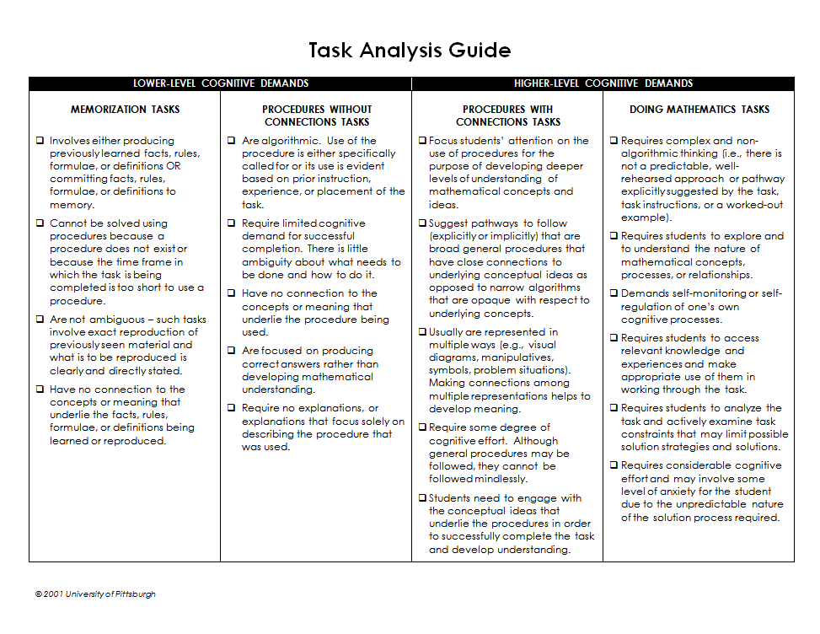
Anticipating
Evaluate the rigor of the task using the Task Analysis Guide.
Modify the task as needed.
Record the agreed upon task on the planning sheet.
✗
✗
✗
✗
✗
✗
✗
Notes:
Instructor Notes: 5 minutes
SAY Please find Handout #2.
SAY Again, if you were a 3rd – 5th grade teacher four to six years ago, you may also remember working with the Task Analysis Guide.
SAY The guide has the characteristics of mathematical tasks at each of the four levels of cognitive demand:
Lower levels, including “memorization tasks” and “procedures without connections” and the
Higher levels, “procedures with connections” and “doing mathematics.”
SAY As stated in “Adding It Up,” a book from the National Research Council, “Tasks form the basis for students’ opportunities to learn what mathematics is and how one does it, yet not all tasks afford the same levels and opportunities for student thinking.”
(CLICK) SAY With your team, your job is to evaluate the cognitive demand of your selected task.
SAY If the task does not align with the level of “Doing Mathematics,” then, just as you would in the classroom, modify the task as needed until you feel it addresses several characteristics found in the “Doing Mathematics Tasks” column.
SAY Once satisfied your task can be categorized as “Doing Mathematics,” record it on Handout #3.
SAY Who can restate what we are about to do?
SAY What questions might you have?

Slide 9
Think  Pair  Share 
There is no decision that teachers make that has a greater impact on students’ opportunities to learn and on their perceptions about what mathematics is than the selection or creation of the tasks with which the teacher engages students in studying mathematics.
- Lappan & Briars, 1995
Notes:
Instructor Notes: 3 minutes
SAY Please take 2 minutes to read, reflect and then discuss the quote with a partner.
SAY Who would like to share something their partner shared with them?
Allow for 2-3 share-outs.

Slide 10
Anticipating
Review the math goals and suggestions for activating prior knowledge.
What might you add to meet the needs of our diverse learners (EL, SEL, SWD, At-Risk, GATE)?
Record ideas on the Interactive Learning handout
Math Goals
Activating Prior Knowledge
Notes:
Instructor Notes: 5 minutes
Present the slide.
SAY You can make notes directly on the Interactive Learning page or write on Post-its.
As you circulate during the grade level discussions, listen for and highlight access to core strategies:
Advanced Graphic Organizers
Cooperative Learning
Instructional Conversations
Academic Vocabulary

Slide 11
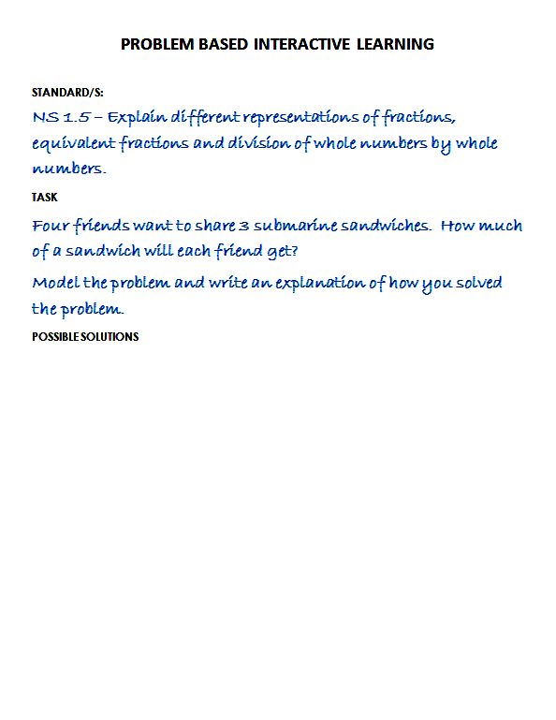
Anticipating
Possible Solution Paths
Solve the problem as many ways as possible on the planning sheet.
Notes:
Instructor Notes: 5 minutes
SAY Now that we’ve made decisions about how to introduce the task while maintaining the rigor, we are going to anticipate as many of the solutions paths as possible.
As grade levels work, circulate and ask guiding questions to encourage multiple solution paths.
What if you had started with ___ rather than ___ ?
What if you could only use ___ ?
How might you organize the information?
How might you guess and check?
How does this relate to ___ ?
What different numbers might you try?
How did you tackle similar problems?
Do you see a pattern? How might you explain it?
What tools might you need?
What might be a more efficient strategy?
How might you use a model to show that?
Refer to the Interactive Learning teacher’s edition page, on the right side, for possible solution paths for each grade level.

Slide 12
Anticipating
Grade Level Discussion:
What misconceptions might students have?
What errors might students make?
Which three student solution paths might be shared during the After phase? Why?
  Number them sequentially and record a rationale.
Notes:
Instructor Notes: 5 minutes
(CLICK) Present the first two bullets for grade level discussion.
(CLICK) Present the final bullet and allow grade level teams time to
Number their solutions paths 1-3
Jot down a brief note next to each solution about the rationale for selection on Handout #3.

Slide 13
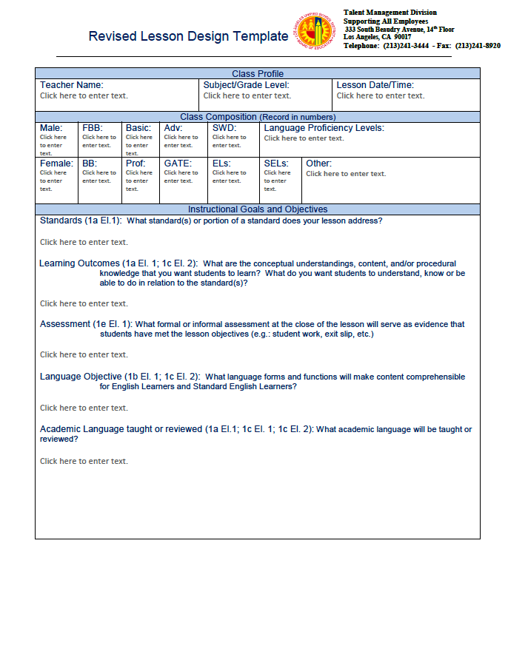
College & Career Ready
Master Plan
Common Core
Teaching & Learning Framework
Lesson Design Template
Instructional Goals and Objectives
Prior Knowledge
Additional Support for Specific Groups of Learners
Notes:
Instructor Notes: 30 seconds
This slide is designed to highlight connections between two of the three LAUSD initiatives.
SAY When we are planning a Common Core lesson aligned with the Three-Phase Structure, we are also addressing components of the Lesson Designed Template associated with the Teaching and Learning Framework .

Slide 14
Think  Pair  Share 
“Pedagogy trumps curriculum. Or more precisely, pedagogy is curriculum, because what matters is how things are taught, rather than what is taught.” (Wilian, 2011)
Common Core Mathematics in a PLC at Work – Larson, Fennell, Lott Adams, Dixon, McCord Kobett, Wray
Notes:
Instructor Notes: 3 minutes
SAY Please take a couple minutes to once again read, reflect and then discuss the quote with a partner.
SAY Who would like to share something their partner shared with them?
Allow for 2-3 share-outs.

Slide 15
The Standards for
Mathematical Practice
Overarching Habits of Mind
MP1 Make sense of problems and persevere in solving them.
MP6 Attend to precision.
Reasoning & Explaining
MP2 Reason abstractly and quantitatively.
MP3 Construct viable arguments and critique the reasoning of others.
Modeling &
Using Tools
MP4 Model with mathematics.
MP5 Use appropriate tools strategically.
Seeing Structure & Generalizing
MP7 Look for and make use of structure.
MP8 Look for and express regularity in repeated reasoning.
Notes:
Instructor Notes: 2 minutes
SAY The Common Core Standards for Mathematical Practice describe how content should be taught in order to ensure that our students are mathematically proficient.
SAY We are now going to make connections between the work we are doing and the Common Core State Standards.
SAY The Common Core is comprised of two kinds of standards, standards for practice and standards for content. Here we see the 8 Common Core practice standards. They are the same for all grades K-12
SAY MP1 & MP6 extend throughout every math lesson. They represent overarching habits of mind exhibited by successful mathematicians.
SAY MP2 & MP3 are described as reasoning and explaining.
SAY MP4 & MP5 are summarized as modeling and using tools.
SAY MP7 & MP8 are described as seeing structure and generalizing.
SAY LAUSD has targeted MP3 as the 2012-2013 focus.
SAY In addition, MP1 and MP4 will be added as the 2013-2014 focus.
SAY You’ll find that when facilitating tasks using Van de Walle’s Three Phase Structure, all eight of the Standards for Mathematical Practice are achievable.
SAY Today, we will focus our attention on practice standard 3.

Slide 16
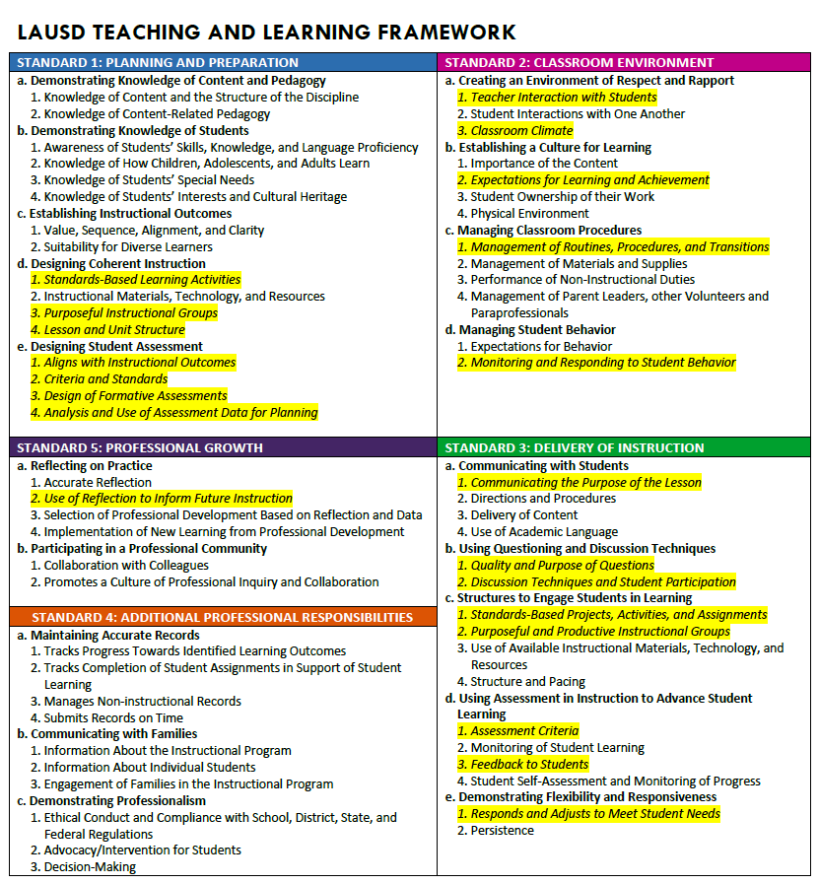
College & Career Ready
Master Plan
Common Core
Teaching & Learning Framework
Standard 3: Delivery of Instruction
b. Using Questioning and Discussion Techniques
Quality and Purpose of Questions
Discussion Techniques and Student Participation
Notes:
Instructor Notes: 30 seconds
This slide is designed to highlight connections between two of the three LAUSD initiatives.
SAY When we are planning with Common Core practice standard 3 in mind, we are also addressing components of the Teaching and Learning Framework.

Slide 17
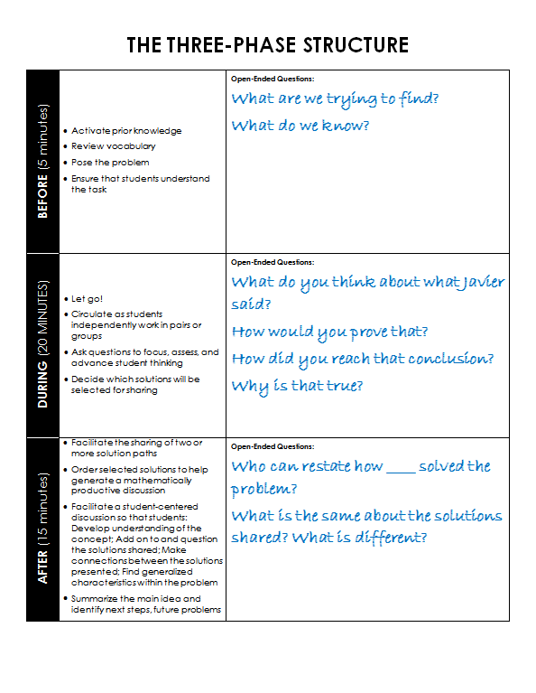
Questioning
Record MP3 aligned questions you will ask during each of the three phases.
Effective questions often begin with How, What, & Why.
A question not asked is a door not opened.
- Marilee Goldberg, The Art of the Question
Notes:
Instructor Notes: 3 minutes
SAY Please find Handout #4.
Present the slide.
SAY Record questions to help ensure that your students both present ideas to peers, and agree and/or disagree with their peers’ ideas.
SAY For example, in the DURING phase, I might want to ask students, “How would you prove that?”
SAY To elicit a viable argument in the AFTER phase, I might ask, “What is the same about both solutions shared? What’s different?”
SAY If you need further inspiration, Handout #5 contains questions that can be used to address the various components of practice standard 3.
The bullets on Handout #5 are taken directly from Common Core Standard for Mathematical Practice 3 (MP3).
If interested in reading more, see page 5 of the LAUSD Common Core State Standards spiral book.

Slide 18
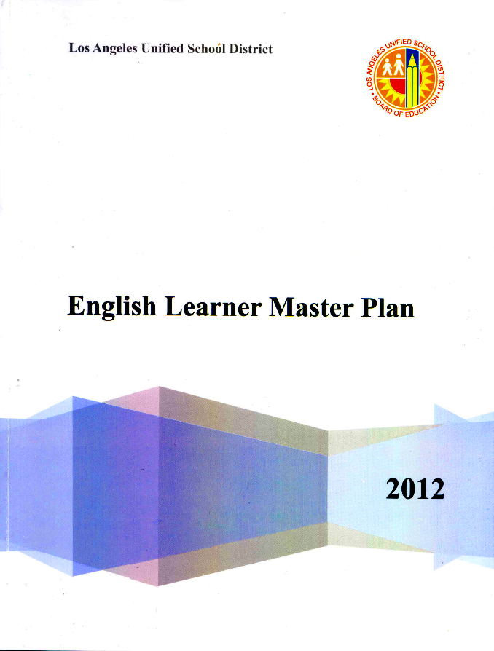
College & Career Ready
Master Plan
Common Core
Teaching & Learning Framework
SDAIE Interactions
Do I provide many different opportunities for students to talk about the lesson concepts?
Do I provide many opportunities for questioning between students and teacher and among students?
Do I plan real-life (authentic) activities that offer opportunities for listening, speaking, reading, and writing?
Notes:
Instructor Notes: 30 seconds
This slide is designed to highlight connections between two of the three LAUSD initiatives.
SAY When we are planning a lesson aligned with Common Core Mathematical Practice 3, we are also addressing components of the English Learner Master Plan.

Slide 19
Grade Level Charting
Create a poster that demonstrates your problem-based learning, including:
The task
Three possible solution paths
A key question for each phase
Notes:
Instructor Notes: 5 minutes
Present this slide.
Posters should be hung around the room in preparation for the upcoming gallery walk.

Slide 20
College & Career Ready
Master Plan
Common Core
Teaching & Learning Framework
Anchor Standards for ELA and Content Literacy
Reading 1: Read closely to determine what the text says explicitly and to make logical inferences from it; cite specific textural evidence when writing or speaking to support conclusions drawn from the text.
Speaking and Listening 1: Prepare for and participate effectively in a range of conversations and collaborations with diverse partners, building on others' ideas and expressing their own clearly and persuasively.
Notes:
Instructor Notes: 30 seconds
This slide is designed to highlight connections between the LAUSD initiatives.
SAY When we are planning a lesson aligned with Common Core Mathematical Practice 3, we are also addressing components of the English Language Arts Common Core Standards.

Slide 21
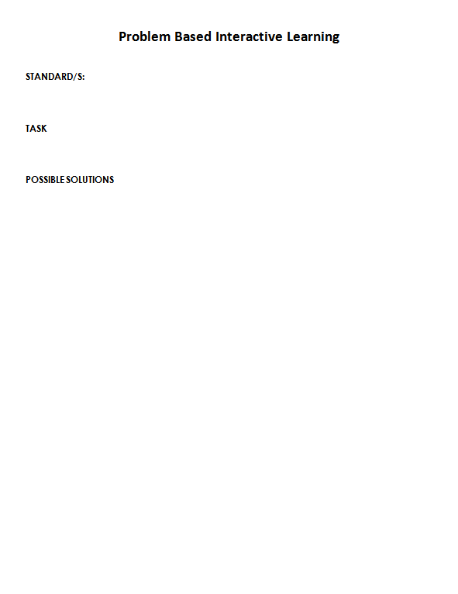
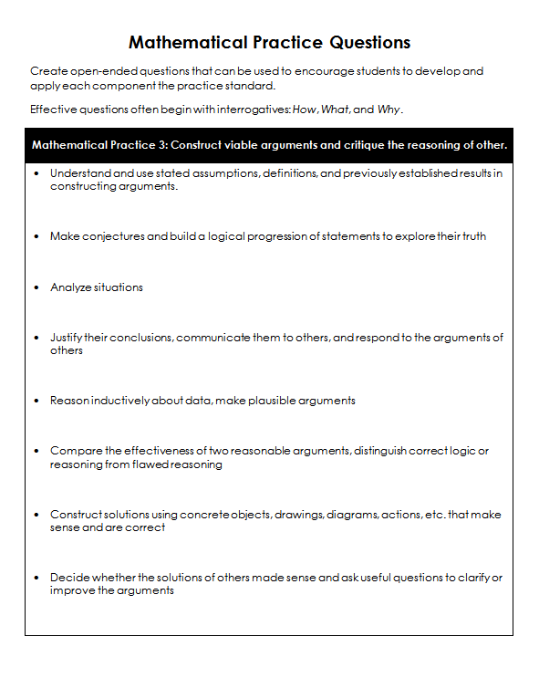
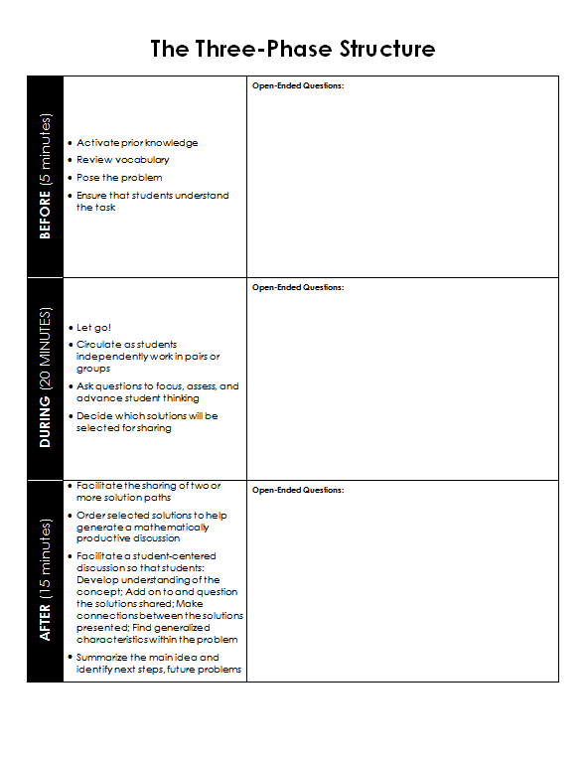
Vertical Articulation
Circulate the room with your school team.
Record new ideas as peers share their posters.
When you arrive at your grade level poster, present the work to your school team.
Notes:
Instructor Notes: 10 minutes
Present the slide.
As school teams circulate, participants should take Handout #4 in order to record questions and ideas sparked by their grade level peers.
Invite participants to take cell phone/tablet pictures as they experience the charts throughout the room.

Slide 22





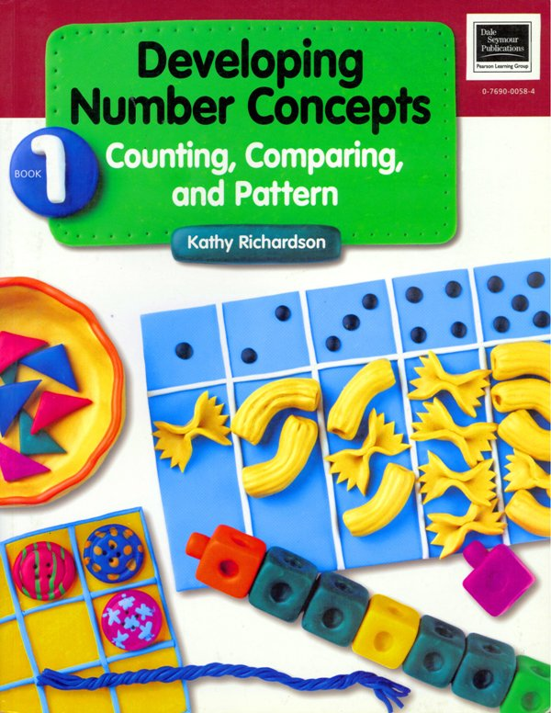
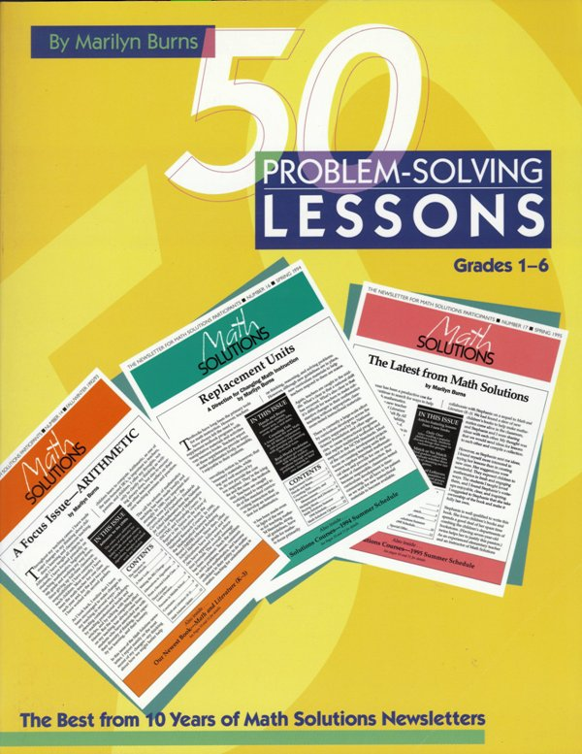


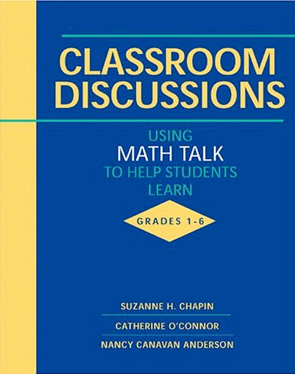
Resources
Literature Connections
Additional Resources
enVisionMATH
Notes:
Instructor Notes: 3 minutes
SAY Today we have worked with Problem-Based Interactive Learning tasks from enVisionMATH and John Van de Walle’s Three-Phase-Structure to create cognitively demanding tasks that address the eight Common Core Standards for Mathematical Practice.
What are other problem solving opportunities in enVisionMATH (end of Topic Performance Assessment, Writing to Explain in the Quick Check, Problem Solving section of each lesson)?
(CLICK) SAY A visit to your school or local public library can unearth literature connections that can be used to further enrich math instruction.
(CLICK) SAY And as we know, in addition to enVisionMATH, rich tasks can be found throughout the additional resources provided the District years ago.

Slide 23

Thank You
“Your goal will be to develop in students both conceptual understanding and procedural fluency of the CCSS content through the collaborative selection of high-cognitive-demand mathematical tasks with a focus on engagement with the Standards for Mathematical Practice”
Common Core Mathematics in a PLC at Work
– Larson, Fennell, Lott Adams, Dixon, McCord Kobett, Wray
Notes:
Instructor Notes: 1 minute
SAY Together we have created discussion-based opportunities for student learning by selecting and planning a cognitively challenging instructional task.
SAY Now imagine this process being carried out collaboratively by each grade-level team back at your school site.
SAY As stated in the book Common Core Mathematics in a PLC at Work, “Gradually, year after year, your collaborative team creates and revises more and more highly effective lessons, thereby continually improving your instruction in small manageable chunks with shared energies rather than in isolation.”
SAY Thank you for helping to ensure that our LAUSD students are on the path to graduate college and career ready.

